Slide 1
ISA-95
Enterprise-Control System Integration Standard
B2MML
Business To Manufacturing Markup Language
Dave Emerson
WBF XML Working Group Chair
dave.emerson@us.yokogawa.com

Slide 2

ISA
ISA
  Professional organization
  Standards developer in association with ANSI
SP95
  The ISA Standards & Practices Committee number 95
  Purpose: To create a standard that will define the interface between control functions and other enterprise functions…
ISA-95
  The actual standard produced by the SP95 committee
  U.S. ANSI/ISA standard
IEC & ISO
  International standards groups
  IEC 62264-1:2003 and IEC 62264-2:2004
  are “dual logo” standards
  International version of ISA-95

Slide 3
Companies Participating in SP95
ABB
Arla Foods
AspenTech
Dupont
Eli Lilly
Emerson Process Management
Fluor
General Electric
Invensys-Wonderware
Lighthammer
Lund University, Sweden
Lyondell – Equistar
Microsoft
Nestle
Novo Nordisk
Proctor & Gamble
Purdue University
Rockwell Automation
SAP
Siemens
Yokogawa

Slide 4
WBF
Professional organization promoting the exchange of information on the management, operation and automation of batch process manufacturing
Initially focused on the ISA-88 batch control standard
  Focus expanded to include ISA-95 to all types of process automation
Working Groups
  Opportunity for WBF members to collaborate
  XML Working Group created B2MML & BatchML

Slide 5
B2MML
Business To Manufacturing Markup Language
  W3C XML Schema implementation of ISA-95
Not a formal standard, an implementation of a standard
Tool for bring together automation & IT groups

Slide 6
ISA-95 & B2MML Status
U.S. Standard | International Standard | B2MML | Title
ANSI/ISA-95.00.01-2000 | IEC/ISO 62264-1:2003 | Released, V0300 | Enterprise - Control System Integration – Part 1: Models and Terminology
ANSI/ISA-95.00.02-2001 | IEC/ISO 62264-2:2004 | Released, V0300 | Enterprise - Control System Integration – Part 2: Object Model Attributes
ANSI/ISA-95.00.03-2005 | JWG 15 in progress | N/A | Enterprise - Control System Integration – Part 3: Activity Models of Manufacturing Operations Management
ISA draft 95.00.04 Draft |  |  | Enterprise - Control System Integration – Part 4: Object Models and Attributes of Manufacturing Operations Management
ISA draft 95.00.05 Draft |  | In Development | Enterprise - Control System Integration – Part 5: Business to Manufacturing Transactions

Slide 7
Why was ISA-95 Created?
Integration of business and manufacturing systems is difficult
  Different Automation & IT cultures, knowledge bases
Lack of consensus and models to follow for integration
Increase in business needs to integrate manufacturing sites with business systems
Business drivers:
  Supply chain optimization
  Asset efficiency
  Agile manufacturing
  Available to Promise & Available to Profit

Slide 8




What ISA-95 Offers
Framework for integration projects
Separation of business processes
from
manufacturing
processes
Focus on functions,
not systems,
organizations
or individuals

Slide 9

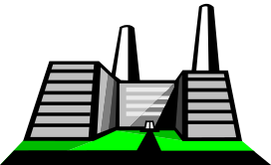



ISA-95 Scope
ENTERPRISE
95.01 & 2
95.03
SITE
AREA
AREA
AREA
CONTINUOUS
PRODUCTION
UNIT
BATCH
PROCESS
CELL
DISCRETE
PRODUCTION
LINE
Notes:
This is one way to look at the scope of S95, dealing mostly with site and area issues, down to the production line, cells, and production units.

Slide 10
Purdue Reference Model
From the Purdue model
  Theodore J. Williams, The Purdue Enterprise Reference Model, A Technical Guide for CIM Planning and Implementation, 1992, ISA, ISBN 1-55617-265-6
Defines the functions in a manufacturing enterprise
Includes details of functions in the control domain
Defines levels in a manufacturing enterprise

Slide 11
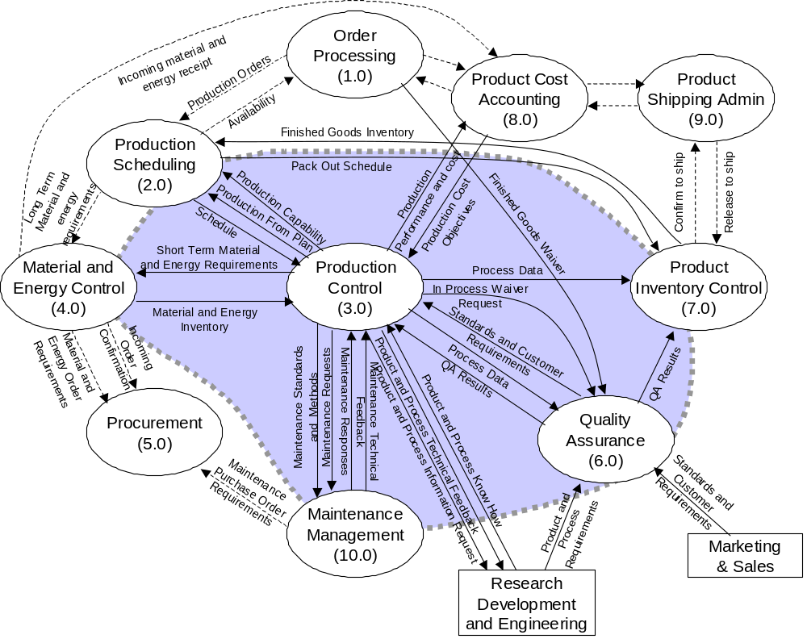
Purdue Reference Model
Enterprise/
Control
Boundary

Slide 12
Information of Interest
Functions
Outside the
Control Domain
Information Flows of interest
(e.g. Production Scheduling)
(e.g. Production Schedule and
Production Results)
Enterprise/Control
System Boundary
Functions detailed
Functions
Within the
Control Domain
Functions not detailed
Data flows detailed
Data flows not detailed
(e.g. Equipment Monitoring)

Slide 13
ISA95.01 Levels
Level 4
Business Planning & Logistics
Plant Production Scheduling,
Operational Management, etc
Interface addressed
Parts 1 & 2
Level 3
Manufacturing
Operations & Control
Dispatching Production, Detailed Production
Scheduling, Reliability Assurance, ...
Area addressed
Parts 3 & 4
Levels
2,1,0
Batch
Control
Continuous
Control
Discrete
Control
Notes:
The figure above is a simplified version of the Purdue model, showing the S95 scope.
Level 4 is high level planning and scheduling and logistics.
Level 3 is manufacturing control,
including operations scheduling - or planning.
Level 2 needs a lot of definition.
Describe S88.01 and the batch model and how it stops at the process cell.
Describe some of the S88.01 models.
There are less well-defined models for continuous and discrete processes.
Continuous is handled somewhat by S88.01, but without the concept of recipes for products, just recipes for product startup and shutdown.
PDXI has a model at least of all of the static information (design of P&IDs) and control loops, but not very dynamic
Discrete models
SME (Society of Mechanical Engineers has some material, but nothing in the ISA /IEC/ISO arena.

Slide 14
Equipment Hierarchy
ENTERPRISE
Enhanced in Part 3
Level 4 activities
typically deal with
these objects
SITE
AREA
Level 3 activities
typically deal with
these objects
PROCESS
CELL
PRODUCTION
UNIT
PRODUCTION
LINE
STORAGE
ZONE
UNIT
WORK
CELL
STORAGE
MODULE
Lower level
equipment used
in batch
production
Lower level
equipment used
in continuous
production
Lower level
equipment used
in repetitive or
discrete production
Lower level
equipment used
for storage

Slide 15
Identified Information Categories
Business planning &
logistics information
Plant production scheduling,
operational management, etc
Product
definition
information
(What must be
defined to make
a product)
Production
capability
information
(What resources
are available)
Production
schedule
information
(What to
make and use)
Production
response
information
(What was
made and used)
Manufacturing operations &
control information
Production operations, maintenance
operations, quality operations, etc

Slide 16
Categories of Information
Business Planning &
Logistics Information
Production
Capability
Production
Definition
Production
Schedule
Production
Response
What to make, when to make it , what to use
Manufacturing Instructions, Recipes, BOM,
What was made and used
Resource Availability
Manufacturing Operations &
Control Information

Slide 17
Major Object Models
Three categories of resources
  Personnel
  Equipment
  Material (and Energy)
Combined resources (logical view)
  Process Segments
Four Models / Production-Process-Product
  Production Schedule
  Production Performance
  Capability Definition (by time & by segment)
  Product Definition
Notes:
Briefly list/discuss topics to be covered in this section.
Duration: Spend approximately 1.5 hours on this section.

Slide 18
Design Patterns
Resources
  Class-Instance models
Major Objects
  Sub-divided into segments
    Each segment has personnel, equipment, material, & data components
Properties
  Few standard object attributes
  Properties used to permit customization

Slide 19
Personnel Model
Personnel
Class
0..n
Person
0..n
Defined by
Has
Properties
of
Has
values for
0..n
0..n
Personnel
Class Property
Maps to
Person
Property
Is tested
by a
1..n
0..n
Qualification
Test
Specification
Qualification
Test
Result
0..n
0..n
Records the
execution of
Defines a
procedure for
obtaining a

Slide 20






Persons and Personnel Classes
Supervisor
Professional
Engineer
Laborer
Operator
Pump
Mechanic
Draftsman
Qualification
Test
Qualification
Test Results
Sally Jones- ID#12344
Joe Smith - ID#12345

Slide 21
Equipment model
Is against
Maintenance
Request
May be made up of
0..n
0..n
0..n
May result in
Equipment
Class
0..n
1..1
Equipment
0..n
Defined by
1..1
0..1
Has
Properties
of
Has
values for
Maintenance
Work Order
0..n
Is made
against
1..1
0..n
0..n
0..n
May be generated for
Equipment
Class Property
Maps to
Equipment
Property
Maintenance
Response
Is tested
by a
1..n
0..n
Equipment
Capability Test
Result
0..n
Equipment
Capability Test
Specification
0..n
Records the
execution of
Defines a
procedure for
obtaining a

Slide 22




Equipment and Classes
Heating Reactor
Mixing Reactor
Maintenance
Request
Capability
Test
Maintenance
Work
Order
HR101
HR102
HMR101
MR101
MR102
Capability
Test Results
Max
Temp =
300 F
Capacity
=
5000 Gal
Shearing
=
TRUE
Capacity
=
3000 Gal

Slide 23
Material model
Material
Class
Defines
a grouping
Material
Definition
0..n
Made up of
Material
Sublot
Material Lot
0..n
0..n
0..n
1..1
Defined by
Has
Properties
of
0..n
Has
Properties
of
Has
values for
May be made up
of sublots
0..n
0..n
0..n
Material
Class
Property
Material
Definition
Property
Maps to
Material Lot
Property
May
map to
Is tested
by a
1..n
0..n
Is associated
with a
Records the
execution of
0..n
QA Test
Result
0..n
QA Test
Specification
Defines a
procedure for
obtaining a

Slide 24
Material Definition Example
Material Class
HCl Acid
Material Definition
HCl 50%
Lot
HCL-50-100019
Sublot
HCL-50-100019
Barrel 15
Material
Class
Material
Definition
pH
Density
Color
Purity
QA Test
Results
QA Test
Specification
Location
pH
1.0
Density
1.05
Color
Straw
Purity
99.5%

Slide 25


Process Segment Model
Personnel resources managed for production
People
Equipment resources managed for production
Equipment
Material resources managed for production
Materials
Collections of resources, used together for production, at the granularity needed for business level scheduling and costing
Segments

Slide 26
Process Segment Model
May be
made up of
0..n
Process
Segment
Is defined as a collection of
0..n
0..n
0..n
0..n
Personnel Segment
Specification
Equipment Segment
Specification
Material Segment
Specification
Process
Segment
Parameter
Has properties
of
Has properties
of
Has properties
of
0..n
0..n
0..n
Personnel Segment
Specification
Property
Equipment Segment
Specification
Property
Material Segment
Specification
Property
0..n
Corresponds
to element in
0..n
Corresponds
to element in
0..n
Corresponds
to element in
1..1
1..1
1..1
Personnel
Model
Equipment
Model
Material
Model

Slide 27

Process Segments
Business view of production
Pharmaceutical Manufacturing
(3 Segments)
Make
Active
Ingredient
Make
Pills
Package
Doses
Raw
Materials
Finished
Products
Inventory tracked
for Active Ingredient
Inventory tracked
for Pills
Inventory tracked
for Pill Packs
Know throughput,
resources and time to
make Active Ingredient
Know throughput,
resources and time to
make Pills
Know throughput,
resources and time to
make Pill Packs

Slide 28

Production, Capability, Product
What to make and resources to use
Production
Schedule
What was made and resources actually used
Production
Performance
What is available for use for production
Product
Time
Capability/Capacity
What is needed to make a product
Product
Definitions

Slide 29


Production Schedule Application
Multiple levels of planning & scheduling
  Quarterly
  Monthly
  Weekly
  Dispatch to Production
Production schedules often must be split to multiple control systems &
multiple process types
ISA-95
Production
Schedule
Dispatching
Setpoints
Batch
Schedule
Setup
&
Instructions
Flowpaths
Continuous
Batch Production
Discrete
Premix
Process
Packaging
Notes:
One production schedule may encompass more than the scope of one control system. In this example the production schedule is broken into separate schedules for different types of packages.

Slide 30
Production Schedule
People
Equipment
Product
Definitions
Materials
Production
Schedule
Segments

Slide 31
Production Schedule Model
Production
Schedule
Is made up of
Corresponds
to a
1..n
Product
Production
Rule
Production
Request
Is made up of
1..n
0..n
Process
Segment
Corresponds
to a
Segment
Requirement
Requested
Segment
Response
May contain
0..n
0..n
0..n
0..n
0..n
0..n
Production
Parameter
Personnel
Requirement
Equipment
Requirement
Material Produced
Requirement
Material Consumed
Requirement
Consumable
Expected
Is associated
to either
1..n
1..n
1..n
1..n
1..n
Personnel
Requirement
Property
Equipment
Requirement
Property
Material Produced
Requirement
Property
Material Consumed
Requirement
Property
Consumable
Expected
Property
Product
Parameter
Corresponds to
element in
Corresponds to
element in
Corresponds to
element in
Corresponds to
element in
Process
Parameter
Personnel
Model
Equipment
Model
Material
Model

Slide 32

Production Performance
People
Product
Definitions
Equipment
Materials
Production
Schedule
Production
Performance
Segments

Slide 33
Production Performance Model
Production
Performance
Is made up of
1..n
Production
Response
Is made up of
Corresponds
to a
1..n
Process
Segment
Segment
Response
May contain
0..n
0..n
0..n
0..n
0..n
0..n
Production
Data
Personnel
Actual
Equipment
Actual
Material Produced
Actual
Material Consumed
Actual
Consumable
Actual
1..n
1..n
1..n
1..n
1..n
Personnel
Actual
Property
Equipment
Actual
Property
Material Produced
Actual
Property
Material Consumed
Actual
Property
Consumable
Actual
Property
Corresponds to
element in
Corresponds to
element in
Corresponds to
element in
Corresponds to
element in
Personnel
Model
Equipment
Model
Material
Model

Slide 34
ISA-95 Functional Hierarchy
Level 4
Business Planning & Logistics
Plant Production Scheduling,
Operational Management, etc
Parts 1, 2 & 5
focus on this
Interface
Level 3
Manufacturing
Operations & Control
Dispatching Production, Detailed Production
Scheduling, Reliability Assurance, ...
Parts 3 & 4
Focus on
Manufacturing
Operations
Levels
2,1,0
Batch
Control
Continuous
Control
Discrete
Control

Slide 35
ISA-95 Part 3 Generic Model
Operations
definitions
Operations
capability
Operations
request
Operations
response
Detailed
scheduling
Resource
management
Tracking
Dispatching
Analysis
Definition
management
Data
collection
Execution
management

Slide 36





4 Sets of Level 3 Activities
Production
Management
Asset
Management
Detailed
scheduling
Detailed
scheduling
resource
management
tracking
resource
management
tracking
dispatching
performance
analysis
dispatching
performance
analysis
definition
management
data
collection
definition
management
data
collection
execution
management
execution
management
Detailed
scheduling
Detailed
scheduling
resource
management
tracking
resource
management
tracking
dispatching
performance
analysis
dispatching
performance
analysis
definition
management
data
collection
definition
management
data
collection
execution
management
execution
management
Inventory
Management
Quality
Management

Slide 37
B2MML
Business To Manufacturing Markup Language
Notes:
The WBF Schemas based upon ISA-95

Slide 38
B2MML
B2MML = Business To Manufacturing Markup Language
Standards based, vendor independent XML schemas based upon ISA-95-1, -2
Enables integration project teams to use ISA-95 during analysis & design then use XML during implementation
Developed and available from the World Batch Forum
  www.wbf.org, www.b2mml.org
  BatchML (ISA-88 based XML schemas) also available

Slide 39
WBF XML Working Group
Working group formed in 2000
  Develop XML schemas for ANSI/ISA 88 and 95 standards
Volunteer organization
  List server defines membership
  Over 100 members – varying levels of activity
B2MML Releases
  Version 1 - April 2002
  Version 2 - September 2003
  Version 2.01 - November 2003
  Version 3 – Under development, 2Q 2005 release expected

Slide 40
B2MML XML Schemas
S95 Common
Schema
S95 Production
Performance Schema
S95 Production
Schedule Schema
S95 Material
Schema
S95 Product
Definition Schema
S95 Personnel
Schema
S95 Process
Segment Schema
S95 Maintenance
Schema
S95 Production
Capability Schema
S95 Equipment
Schema

Slide 41
Equipment Model
Information About
Equipment Classes
Information
About Equipment
May be made up of
0..n
Equipment
Class
0..n
Equipment
0..n
Defined by
Has
properties
of
Has
values for
0..n
0..n
Equipment
Class Property
Maps to
Equipment
Property
Is tested
by a
1..n
0..n
Equipment
Capability Test
Result
Information About
Capability Tests
0..n
Equipment
Capability Test
Specification
0..n
Records the
execution of
Defines a
procedure for
obtaining a

Slide 42
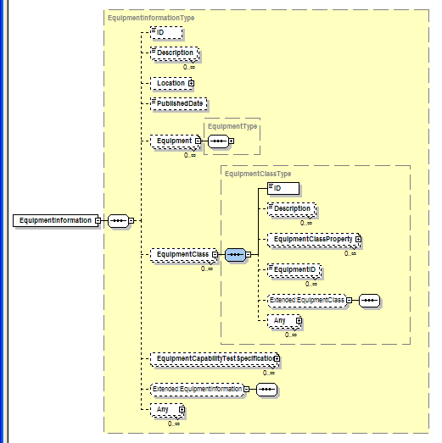
Equipment Schema

Slide 43
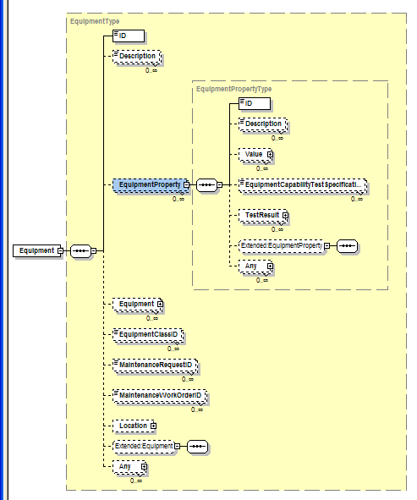
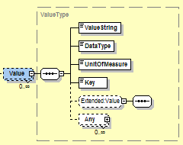
Equipment Properties

Slide 44
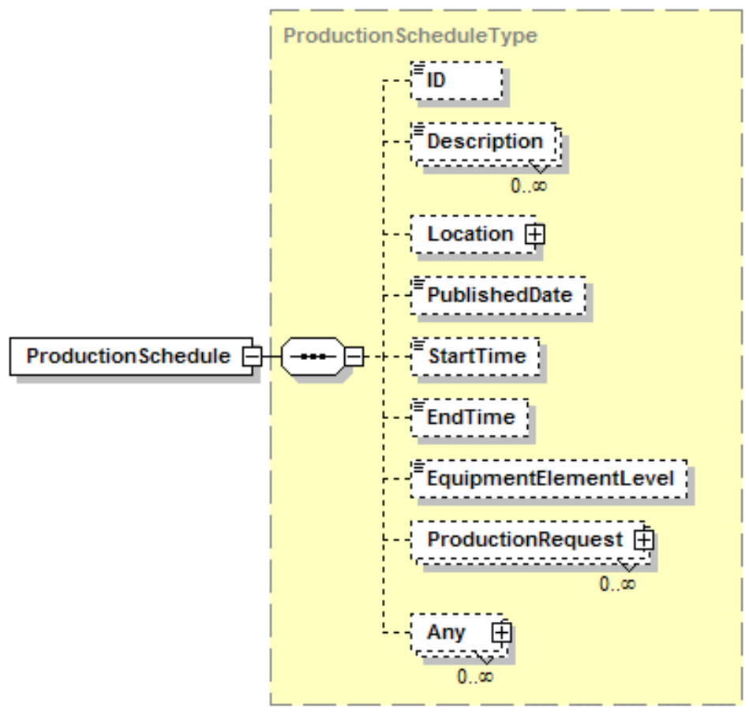
Production Schedule
ISA 95 defines a Production Schedule as a collection of Production Requests, so it is a container object
Defines the “Location” (the scope of the schedule – ie. “Area 54”)
  “EquipmentElementLevel is a hold-over from previous versions and is no longer needed)
Defines the start and end time for the schedule
  Basically the time scope the schedule covers

Slide 45
Production Performance
Production Performance
  ID
  Start & End Time
  Production Response
    ID
    Start & End Time
    Segment Response
      ID
      Start & End Time
      Production Data
      Personnel Actual
      Equipment Actual
      Material Produced Actual
      Material Consumed Actual
      Consumable Actual
      Segment Response
Production
Performance
Is made up of
1..n
Product
Production
Rule
May Correspond
to a
Production
Response
Is made up of
1..n
Process
Segment
Corresponds
to a
Segment
Response
May contain
0..n
0..n
0..n
0..n
0..n
0..n
Production
Data
Personnel
Actual
Equipment
Actual
Material
Produced
Actual
Material
Consumed
Actual
Consumable
Actual
1..n
1..n
1..n
1..n
1..n
Personnel
Actual
Property
Equipment
Actual
Property
Material Produced
Actual
Property
Material Consumed
Actual
Property
Consumable
Actual
Property
0..n
Corresponds to
element in
(see Figure 1)
0..n
Corresponds to
element in
(see Figure 1)
0..n
Corresponds to
element in
(see Figure 1)
0..n
Corresponds to
element in
(see Figure 1)
1..1
1..1
1..1
Personnel
Model
Equipment
Model
Material
Model
1..1

Slide 46
ISA-95 Part 5
Transactions
Use of OAG Verb-Noun Structure

Slide 47
Get/Show Equipment
GET Equipment
Application Identification Area
Information Provider
Data Area
Information User
VERB = GET
Noun = Equipment
ID= “ABC”
GET
Local
processing
SHOW Equipment
Application Identification Area
Data Area
VERB = SHOW
Noun = Equipment
ID= “ABC”
Description = “Simple equipment”
Equipment Property
ID = “Throughput”
Value = 200 PPM
Description = “Throughput as parts
per minute”
…
SHOW

Slide 48
Production Planning & Scheduling Scenario
Level 4
PLM
Level 4
Asset Mgt
Level 4
Production Planning & Capacity Analysis
Level 4
Inventory Mgt
SHOW Product Definition
SHOW Equipment
PROCESS Production Capability
PROCESS Production Schedule
PROCESS Production Performance
GET Product Definition
GET Equipment
PROCESS MaterialSubLot
Level 3
Product Definition Management
Level 3
Production Resource Mgt
Level 3
Detailed Scheduling
Level 3
Production Tracking
Communication within Levels 3 or 4 are not shown since they are not in the scope of ISA-95 Parts 1 and 2

Slide 49
OAGIS 9.0 Nouns (Red are P2B Related)
ActualLedger | EmployeeWorkSchedule | MoveWIP | ReceiveDelivery
AllocateResource | EmployeeWorkTime | OnlineOrder | ReceiveItem
BOD | EngineeringChangeOrder | OnlineSession | RecoverWIP
BOM | EngineeringWorkDocument | Operation | RequireProduct
BudgetLedger | Field | Opportunity | Requisition
CarrierRoute | InspectDelivery | PartyMaster | RFQ
Catalog | InventoryBalance | Payable | RiskControlLibrary
ChartOfAccounts | InventoryConsumption | PaymentStatus | Routing
ConfirmWIP | InventoryCount | PaymentStatusIST | SalesLead
CostingActivity | Invoice | Personnel | SalesOrder
Credit | InvoiceLedgerEntry | PickList | SequenceSchedule
CreditStatus | IssueInventory | PlanningSchedule | Shipment
CreditTransfer | ItemMaster | PriceList | ShipmentSchedule
CreditTransferIST | JournalEntry | ProductAvailability | ShipmentUnit
CurrencyExchangeRate | Location | ProductionOrder | SplitWIP
CustomerPartyMaster | LocationService | ProjectAccounting | SupplierPartyMaster
DebitTransfer | MaintenanceOrder | ProjectMaster | UOMGroup
DebitTransferIST | MatchDocument | PurchaseOrder | WIPStatus
DispatchList | MergeWIP | Quote
ActualLedger | MoveInventory | Receivable
Nouns listed as of 2005-06 that are not in OAGIS 9.0: AllocateProduct, ProductRequirement, ReceiveInventory,

Slide 50
ISA-95 Objects & Nouns(?)
Consumable Actual Property | Maintenance Response | Material Specification Property | Process Segment Parameter
Consumable Actual | Maintenance Work Order | Material Specification | Process Segment
Consumable Expected Property | Manufacturing Bill | Material Sublot Property | Product Definition
Consumable Expected | Material Capability Property | Material Sublot | Product Parameter
Equipment | Material Capability | Person Property | Product Segment Dependency
Equipment Actual Property | Material Class Property | Person | Product Segment
Equipment Actual | Material Class | Personnel Actual Property | Production Capability
Equipment Capability Property | Material Consumed Actual Property | Personnel Actual | Production Data
Equipment Capability Test Result | Material Consumed Actual | Personnel Capability Property | Production Parameter
Equipment Capability Test Specification | Material Consumed Requirement Property | Personnel Capability | Production Performance
Equipment Capability | Material Consumed Requirement | Personnel Class Property | Production Request
Equipment Class Property | Material Definition Property | Personnel Class | Production Response
Equipment Class | Material Definition | Personnel Requirement Property | Production Schedule
Equipment Property | Material Lot Property | Personnel Requirement | QA Test Result
Equipment Requirement Property | Material Lot | Personnel Segment Specification Property | QA Test Specification
Equipment Requirement | Material Produced Actual Property | Personnel Segment Specification | Qualification Test Result
Equipment Segment Specification Property | Material Produced Actual | Personnel Specification Property | Qualification Test Specification
Equipment Segment Specification | Material Produced Requirement Property | Personnel Specification | Requested Segment Response
Equipment Specification Property | Material Produced Requirement | Process Parameter | Segment Requirement
Equipment Specification | Material Segment Specification Property | Process Segment Capability | Segment Response
Maintenance Request | Material Segment Specification | Process Segment Dependency | Transaction Profile

Slide 51
Possible Mappings
ISA-95/B2MML
Personnel Class / Person
Equipment Class / Equipment
Material Definition / Class / Lot / Sublot
Process Segment
Product Segment
Production Capability
Product Definition
Production Schedule
Production Performance
OAGIS
Perssonel, PersonNameGroup, EmployeeGroup, Skill, PersonnelQualification
ItemMaster, WorkCenter
ItemMaster/ItemHeader/
ItemLocation LotNumberSpecification
InspectionSpecificationReference
Operation (BOM Reference, RouteReference)
Routing, ProductionOrder
ProductionOrder, DispatchList
ProductionOrder, WIPStatus, ConfirmWIP

Slide 52
Summary
ISA’s SP95 committee produces the ISA-95 standard
  Provides framework for integration
  Work continues on Parts 3, 4 & 5
WBF provides tools for implementing ISA-95
  XML schema implementation of ISA-95
  Defacto implementation for ISA-95
Manufacturing Interoperability Guideline Working Group
  Need to converge with OAG to provide manufacturing industries with a consistent set of standards & implementations

